Slide 1

Piano Keyboard
Keyboard
https://www.musictheory.net/exercises/keyboard/y9dyyynb6ub
Press ⌘ ENTER then the links will work
Intervals
https://www.musictheory.net/exercises/keyboard-interval/dyynbfwby
Mix of both!
https://www.gimkit.com/practice/673b447ecd445b4c6dfa5ec7

Slide 2
Piano Keyboard

Slide 3
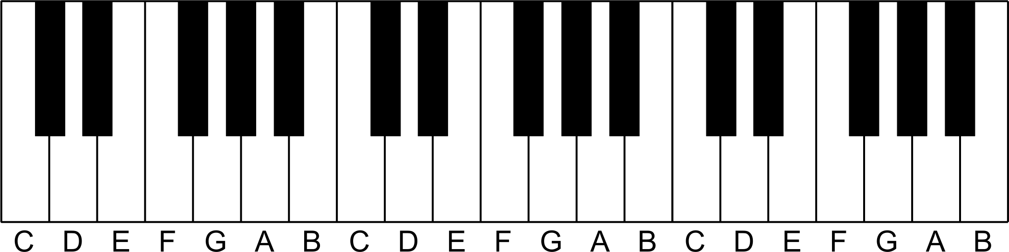
Black and white keys
The piano has a consistent arrangement of white and black keys.

Slide 4
Black and white keys
The black keys come in groups of two or three.

Slide 5
The note E is always next to the group of two black keys

Slide 6
Octaves
Why are there so many keys, but only 7 note names?
The note C on the left is one octave below the next C.

Slide 7
Find the note D
D is in "duh" middle of the pair of black keys.

Slide 8
Find the note F
F is in "front" of the group of three black keys.

Slide 9
Find the note B
B is "behind" the group of three black keys.

Slide 10
Whole-steps & half-steps
Two notes that are next to each other with no notes in between are a half-step apart.
Also called a minor second
B & C are a half-step apart
C & D are NOT

Slide 11
Whole-steps & half-steps
Two notes that are next to each other with a single note in between are a whole-step apart.
Also called a major second
C & D are a whole-step apart
E & F are NOT

Slide 12
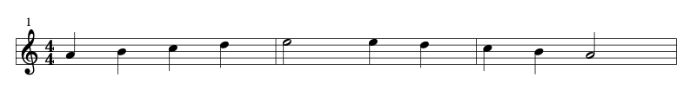

Scales
Scales are a simple musical idea.
Pick a few notes and play them in order.
For example, play the notes A B C D E and then play them backwards.

Slide 13
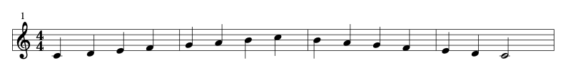
C Major Scale
The C major scale uses 7 different notes: A B C D E F G.
Play them in the order C D E F G A B
Usually play an extra C at the end and then play it all backwards.

Slide 14
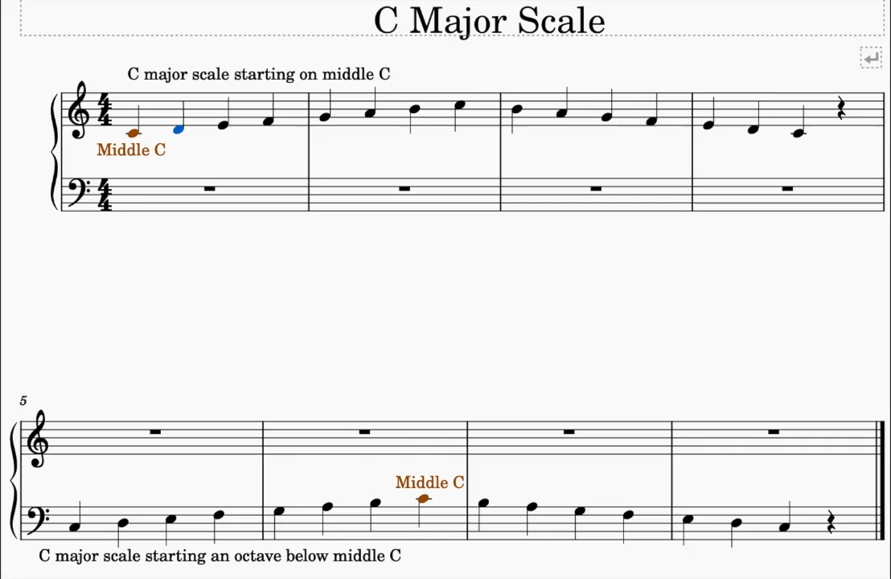

Slide 15
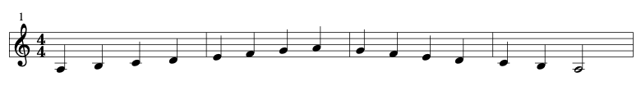
A Minor Scale
The A minor scale uses 7 different notes: A B C D E F G.
Play them in the order A B C D E F G
Usually play an extra A at the end and then play it all backwards.

