Slide 1
Music Reading 101

Slide 2

Staff

Slide 3
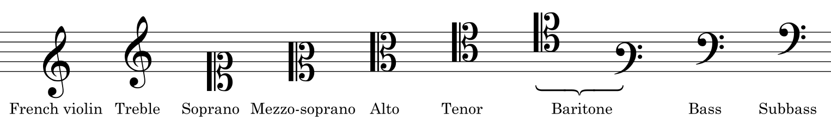
Clef

Slide 4
The Musical Alphabet
A B C D E F G
Music only uses these seven letter names. After G, the alphabet starts over — one octave higher. To name any note, find the anchor note for your clef and count up or down from there.

Slide 5

G Clef
aka Treble Clef
The G clef is a stylized letter G. Its curl circles the second line from the bottom — that line is your anchor note: G.
Count up or down the musical alphabet from G to name any other note.

Slide 6
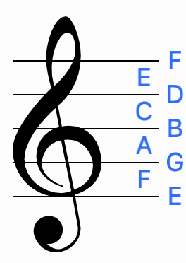
Reading from G

Slide 7
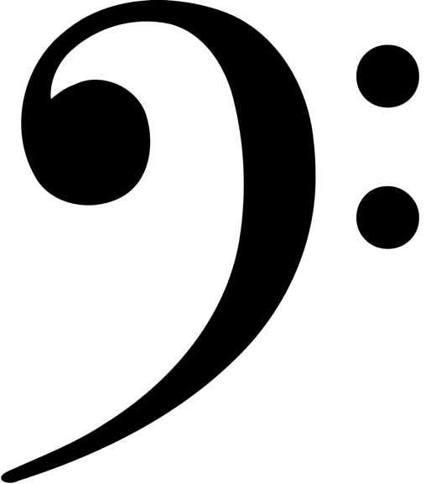
F Clef
aka Bass Clef
Connect the two dots and the stem of the F clef and you can see the letter F. The large dot sits directly on the fourth line from the bottom — that line is your anchor note: F.
Count up or down the musical alphabet from F to name any other note.

Slide 8
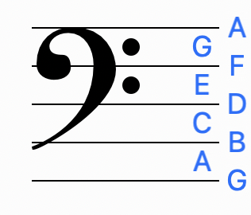
Reading from F

Slide 9

C Clef
aka Alto or Tenor Clef
The C clef forms an arrow pointing at the line where middle C lives. Wherever the arrow points is your anchor note: middle C.
The C clef can sit on different lines depending on the instrument, but the arrow always marks middle C.

Slide 10
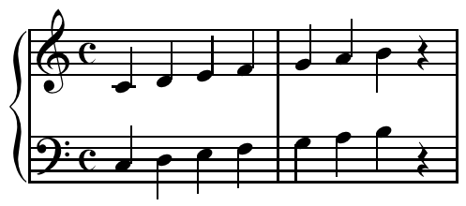
The Grand Staff

Slide 11
Before we go on, let’s practice some
Treble Clef & Bass Clef WITH helpers
Treble Clef & Bass Clef NO helpers

Slide 12
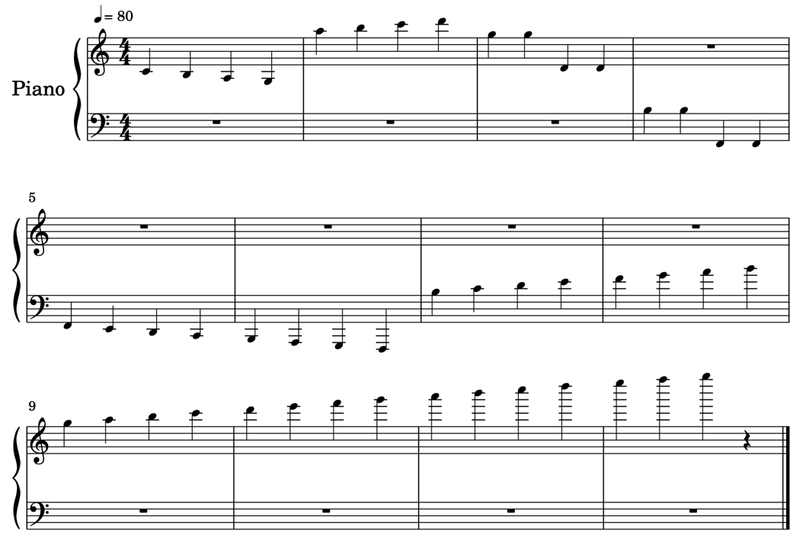

Ledger Lines – Ledger Spaces
Used to extend the range of notes above and below the staff.

Slide 13
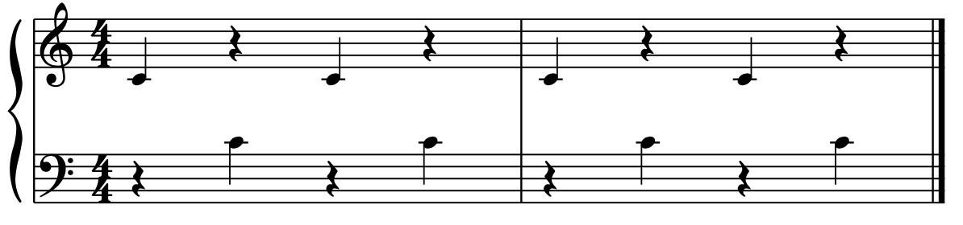
Middle C
The note between the treble and bass clef.

Slide 14
Practice Reading Grand Staff
Practice Reading Grand Staff
OR practice any of the previous exercises.
Start where you can succeed and move up from there.

